Slide 1
TEAM, BUSINESS & MOBILE APP
Pawsitive Pet
Academy
Our team, the business, our logo, JavaScript and the mobile app
PRESENTED BY: AMAN YOUSUF | GROUP LEADER
XHAW5112w
Group 7
Notes:
Slide 1 — Title (camera on)
“Hi, I’m Aman Yousuf, student number ST10542101, and I’m the group leader for Group 7. I’ll introduce our team and the business, explain our logo, then show the JavaScript on our website and our Kotlin mobile app.”

Slide 2
PAWSITIVE PET ACADEMY • OUR TEAM
Meet the team
Four members, each responsible for a part of the project
A
S
A
J
Aman Yousuf
Sandra
Aiyeesha
Jishan
ST10542101
ST10542052
ST10540802
ST10534359
Group leader
Website pages
Design
Team member
Coordination, JavaScript (drop-down, fees calculator, form validation), three course pages and the Kotlin app
About, Contact, Fees, Pet Grooming and Animal Behaviour pages, plus the website demo
Colours, layout and Figma wireframes, Home page, Courses page and course pages
Advisor, researcher, spell-checker and fact-checker
Notes:
Slide 2 — Meet the team
“Our team is Sandra, who built most of the website pages and walks you through the website. Aiyeesha, who did the design, the wireframes, the Home page and the Courses page. And me: I coordinated the group, wrote the JavaScript, built three course pages and built the mobile app.”
(Mention Jishan only if you’ve decided to.)

Slide 3
PAWSITIVE PET ACADEMY • THE BUSINESS
Pawsitive Pet Academy
A pet care and training academy in Durban
4
About the academy
six-month courses · R1,500 each
Canine Obedience Training, Pet Grooming, Animal Behaviour, Pet Business Management
Pet care and training academy in Durban
Founded in 2023 by Sarah Smith
Teaches pet owners and aspiring pet professionals
Seven courses in care, training, grooming and business
3
six-week courses · R750 each
Puppy Care, Pet First Aid, Basic Dog Walking
Discounts: 1 course 0% • 2 courses 5% • 3 courses 10% • 4+ courses 15% | 15% VAT added after discount
Notes:
Slide 3 — The business
“Our client is Pawsitive Pet Academy, a pet care and training academy in Durban, founded in 2023 by Sarah Smith. It offers seven courses. Four are six-month courses at R1,500 each, and three are six-week courses at R750 each. Students get 5% off for two courses, 10% for three and 15% for four or more, and 15% VAT is added after the discount.”

Slide 4




PAWSITIVE PET ACADEMY • THE BUSINESS
How the website and app help
Solving everyday problems for the academy and its customers
Course info any time
Instant quotes
Customers see every course, price and duration without phoning or visiting.
Discounts and VAT are worked out automatically, saving staff time and avoiding mistakes.
Easy enquiries
On the go
The contact form and details bring in new students, even after hours.
The mobile app lets customers choose courses and get a quote on their phone.
Notes:
Slide 4 — How the website and app help
“The website and app solve four problems for the academy. Customers can see every course and price at any time without phoning. They get an instant quote with the discount and VAT already worked out, which saves staff time. They can send an enquiry even after hours. And the app lets them do all of this on their phone.”

Slide 5

PAWSITIVE PET ACADEMY • BRANDING
Our logo
A simple mark that says "pets" and "care" at a glance
Why this design
Paw print
Shows straight away that the academy is about pets.
Heart
Represents the care and love behind every course.
Teal colour
Calm and trustworthy, and used across the website and app.
Simple shape
Stays clear when small, e.g. in the browser tab or as an app icon.
Notes:
Slide 5 — Our logo
“This is our logo. The paw print shows straight away that the academy is about pets, and the heart represents the care behind every course. We used teal because it feels calm and trustworthy, and we use it across both the website and the app. The shape is simple, so it stays clear even when it’s small, like in a browser tab or as an app icon.”

Slide 6
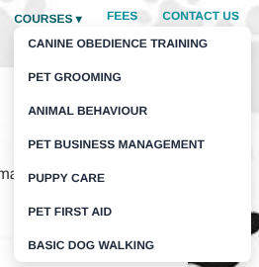
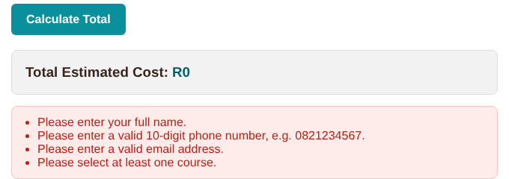
PAWSITIVE PET ACADEMY • JAVASCRIPT
Drop-down menu and error handling
All of our JavaScript lives in one file: script.js
Drop-down menu
Courses drop-down
Built from a list of the seven courses, so it appears on every page without repeating HTML.
Shows all 7 course pages from any page
Fees form checks
Name, a 10-digit phone number starting with 0, a valid email and at least one course.
Clear messages
A red box lists exactly what is wrong and the total stays at R0.
Contact form
Checks name, email and message, then shows a thank-you message.

Slide 7
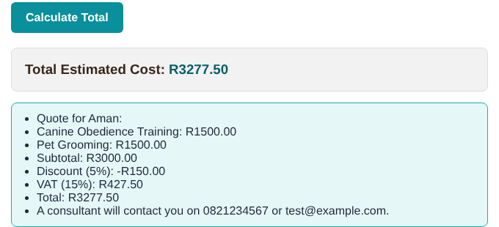
PAWSITIVE PET ACADEMY • JAVASCRIPT
The fees calculator
Selected courses are stored in an array and the quote is built from it
1
Ticked courses are added to an array
2
Subtotal adds up the prices in the array
3
Discount set by the number of courses
4
15% VAT added to the discounted amount
Example: Canine Obedience + Pet Grooming
R3,000 − 5% = R2,850 + 15% VAT = R3,277.50
5
Quote lists each course, subtotal, discount, VAT and total

Slide 8

PAWSITIVE PET ACADEMY • WEBSITE
Responsive and published
Works on phones, tablets and computers
How we made it responsive
CSS media queries at 900px, 768px and 600px
The menu wraps and cards stack into one column
Images and text resize to fit small screens
Same teal and white look as our wireframes and app
Published with GitHub Pages:
aman-yousuf.github.io/XHAW-Assignment-2

Slide 9
PAWSITIVE PET ACADEMY • MOBILE APP
The Kotlin mobile app
Built in Android Studio to match our wireframes and website
Welcome
Home
Courses
Pet Care · Training · Grooming
Calculate Fees
Confirm booking
Remembers choices
Checks details
Same quote as the website
A Booking object stores the chosen courses and prices in ArrayLists, so users can pick from different screens.
Name, a 10-digit phone number and a valid email are checked, with an error shown on the field.
Subtotal, discount, 15% VAT and total appear in a quote pop-up before the booking is confirmed.

Slide 10
Up Next
Up next: the website
Website
aman-yousuf.github.io/XHAW-Assignment-2
GitHub repo
github.com/Aman-Yousuf/XHAW-Assignment-2
Mobile app
Kotlin project in the PawsitivePets folder of the repo
XHAW5112w
Group 7

Slide 11
WEBSITE PRESENTATION
Pawsitive Pet
Academy
Website design, pages and functionality
PRESENTED BY: SANDRA | WEBSITE
XHAW5112w
Group 7

Slide 12
PAWSITIVE PET ACADEMY • WEBSITE DESIGN
02
A website for confident pet care
Introducing the purpose of Pawsitive Pet Academy
What the website is for
Pawsitive Pet Academy presents learning opportunities in animal care, behaviour, grooming and pet-related skills.
The website helps visitors explore courses, compare fees and find ways to contact the academy.

Slide 13
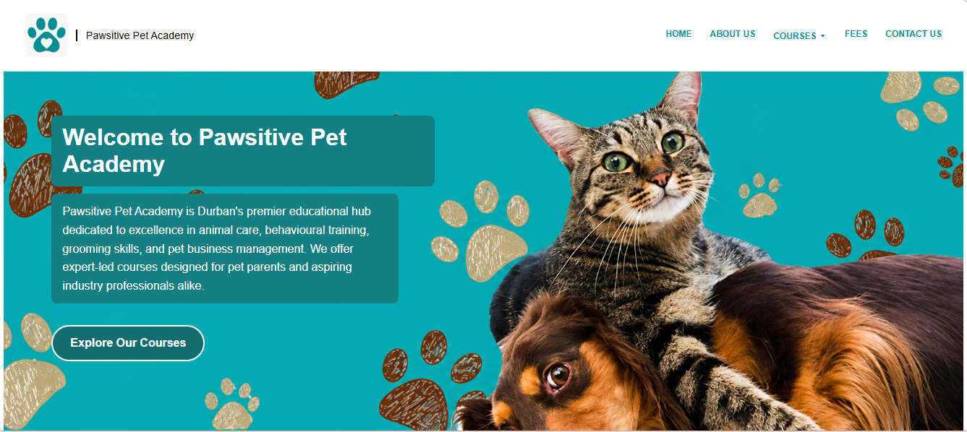
PAWSITIVE PET ACADEMY • WEBSITE DESIGN
03
Homepage design
A welcoming first impression with clear pathways
Key design choices
Teal and white
Creates an appropriate, calm and welcoming feel for pet owners.
Paw-print visuals
Connects the visual identity to pets and animal care.
Clear navigation
Helps visitors move between the main pages.
Course call-to-action
Encourages visitors to explore available courses.

Slide 14
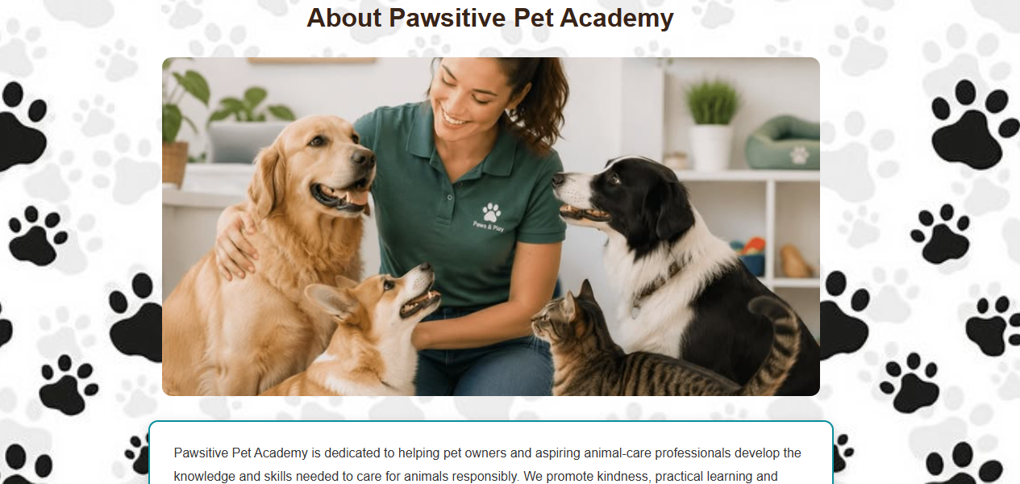
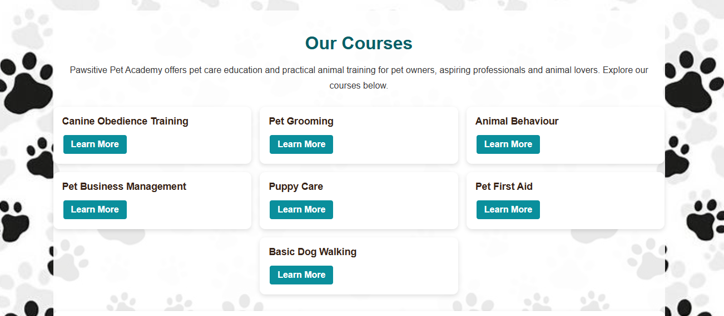
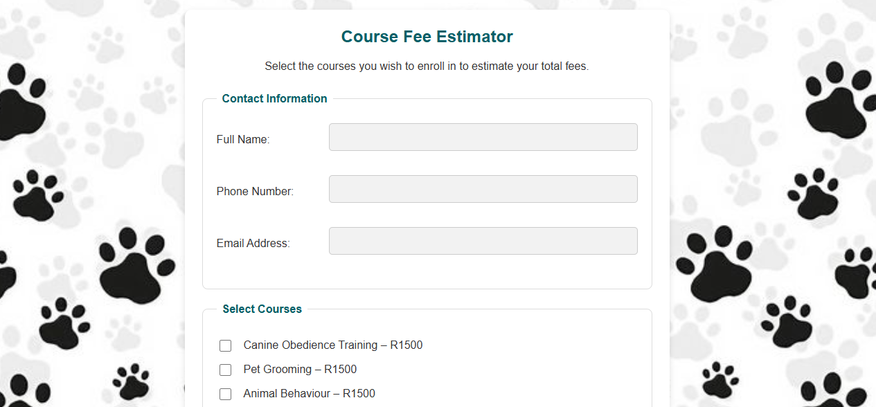
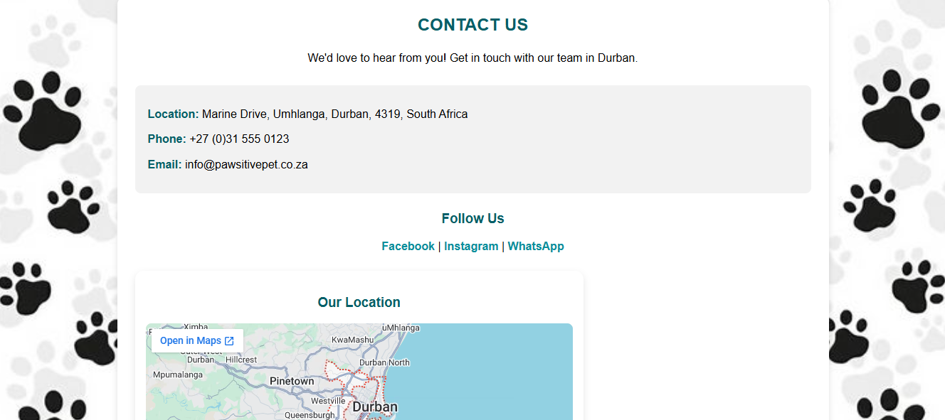
PAWSITIVE PET ACADEMY • WEBSITE DESIGN
04
Pages and navigation
The main pages work together to guide the visitor
HOME
ABOUT US
COURSES
FEES
CONTACT US

Slide 15
PAWSITIVE PET ACADEMY • WEBSITE DESIGN
05
Website functionality
Features that support a straightforward visitor journey
COURSES PAGE
Consistent navigation
The same main menu appears across the website.
Course information
Visitors can review course names and descriptions.
Fees and discounts
Pricing and multi-course discount rules are presented.
Internal links
Buttons and course links guide visitors to relevant pages.
Responsive layout
The layout is designed to adapt to different screen sizes.

Slide 16
PAWSITIVE PET ACADEMY • WEBSITE DESIGN
06
Why these design decisions?
The design aims to make the website welcoming, consistent and easy to use
Visual identity
User experience
• Teal is used as the main accent colour.
• White space keeps content readable.
• Paw-print imagery reinforces the pet theme.
• Repeated page styling creates consistency.
• Clear page names make navigation predictable.
• Course and fee details are grouped logically.
• Links help visitors move to relevant information.
• A simple layout supports quick scanning.

Slide 17
Mobile Application Wireframes
by Aiyeesha Muzvondiwa

Slide 18
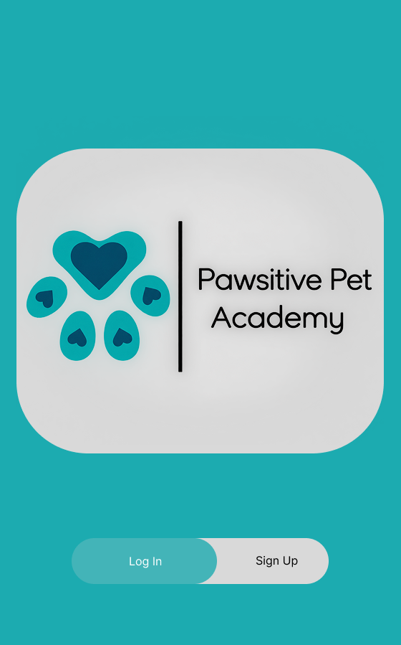

Slide 19
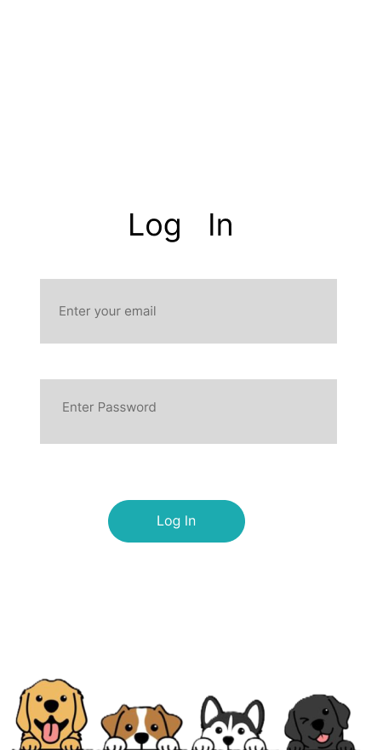

Slide 20
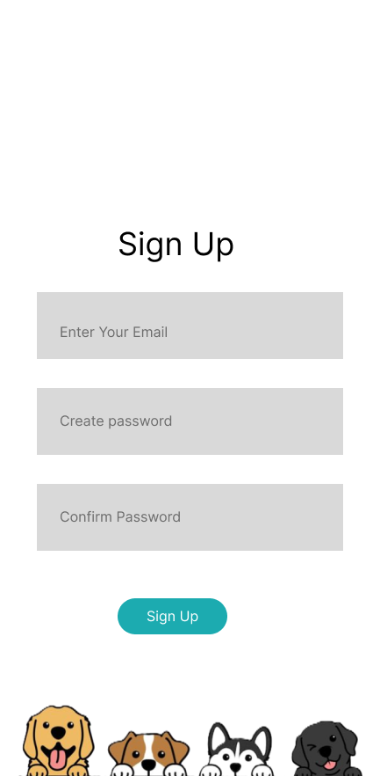

Slide 21
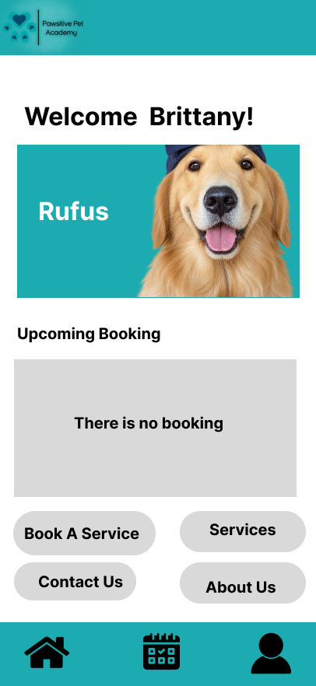

Slide 22
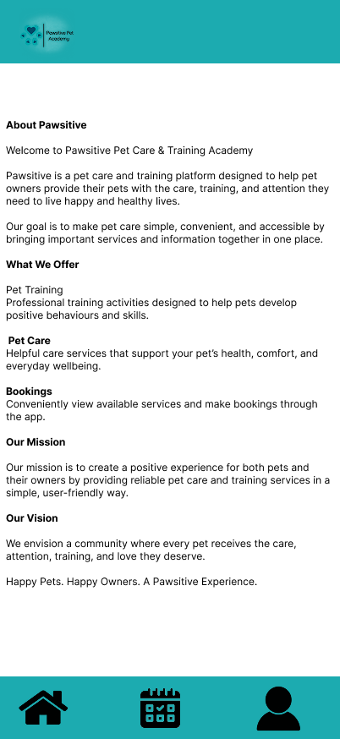

Slide 23
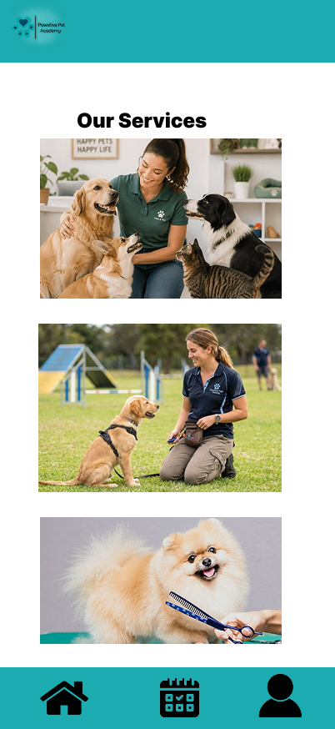

Slide 24
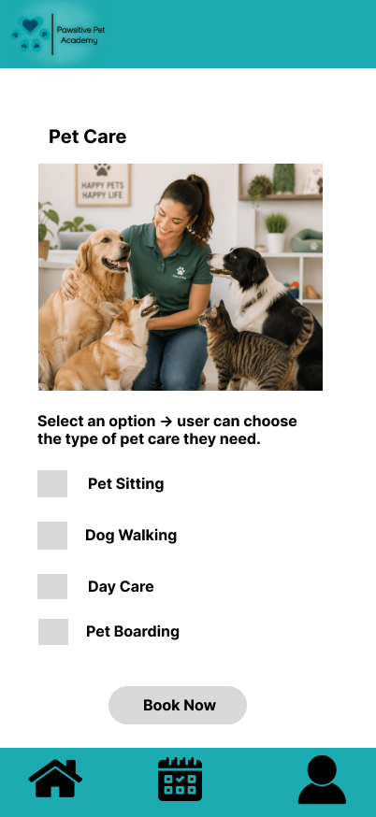

Slide 25
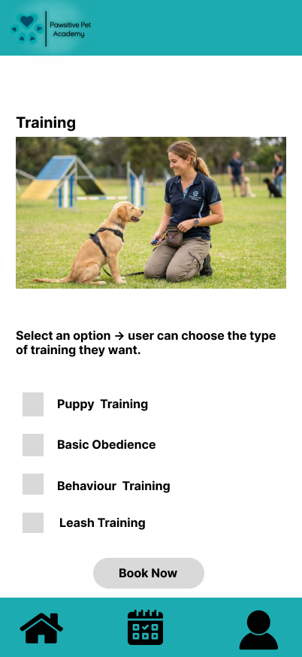

Slide 26
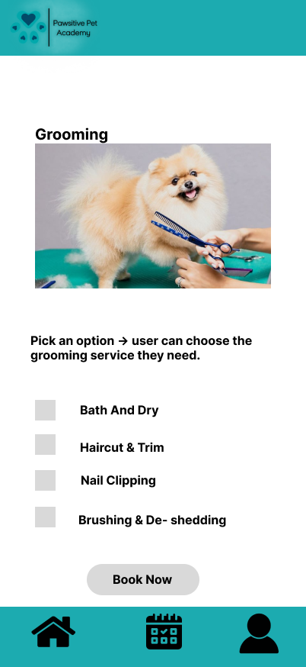

Slide 27
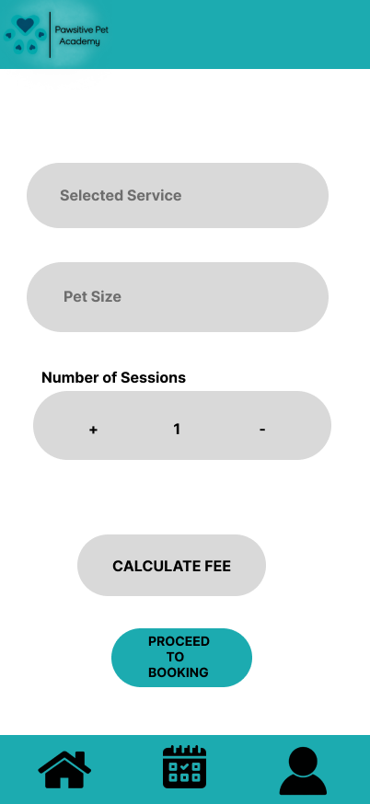

Slide 28
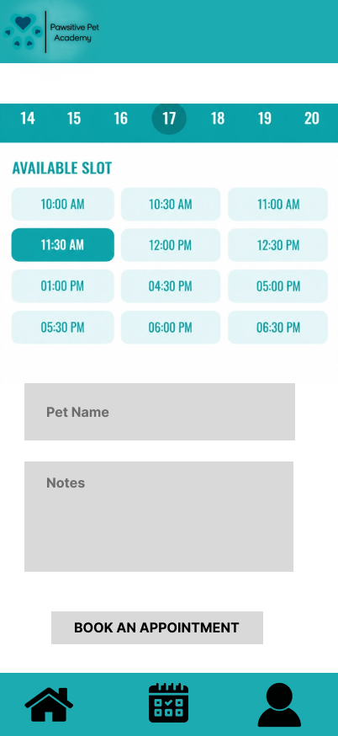

Slide 29
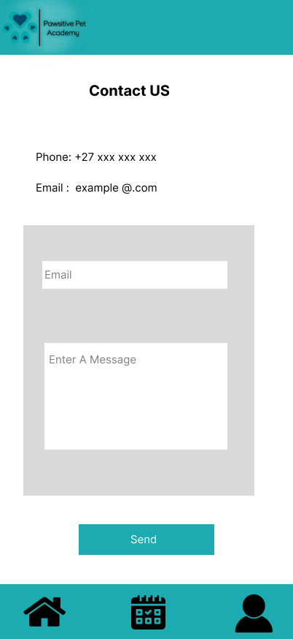

Slide 30
Website Wireframes
by Aiyeesha muzvondiwa

Slide 31
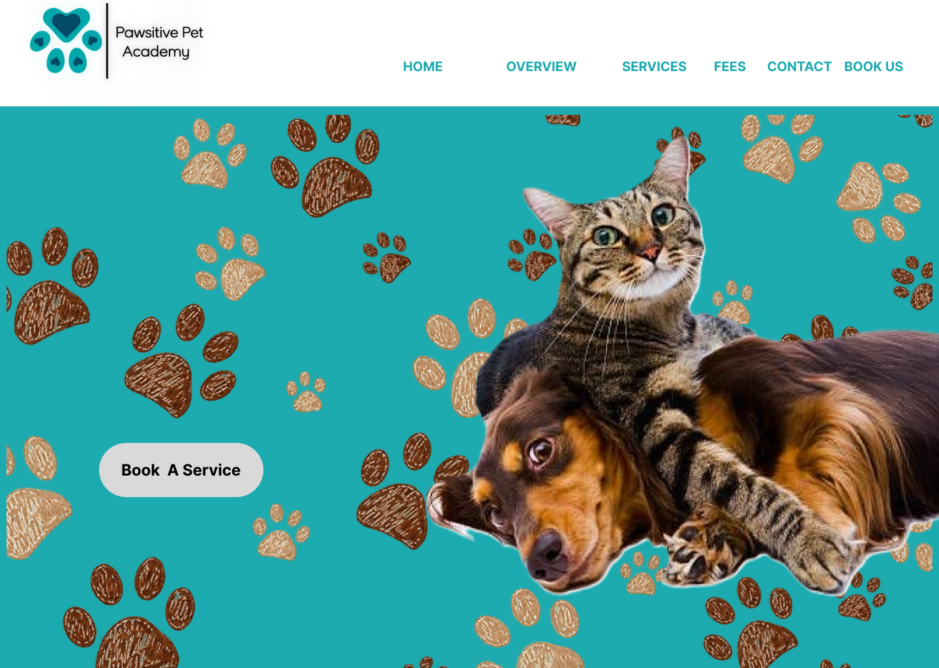

Slide 32
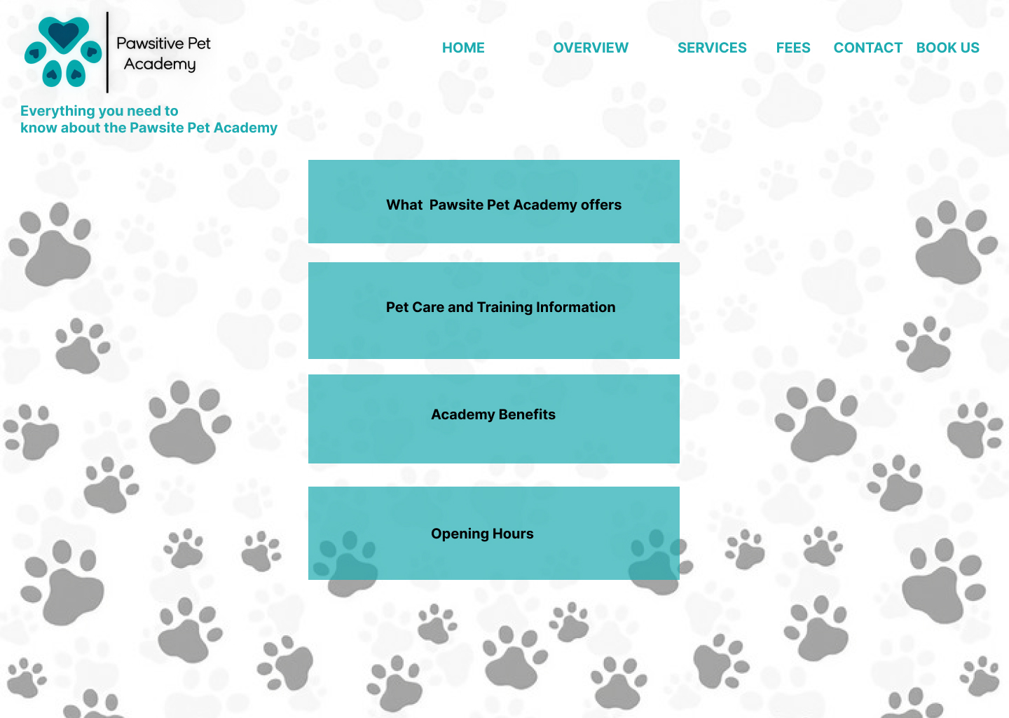

Slide 33
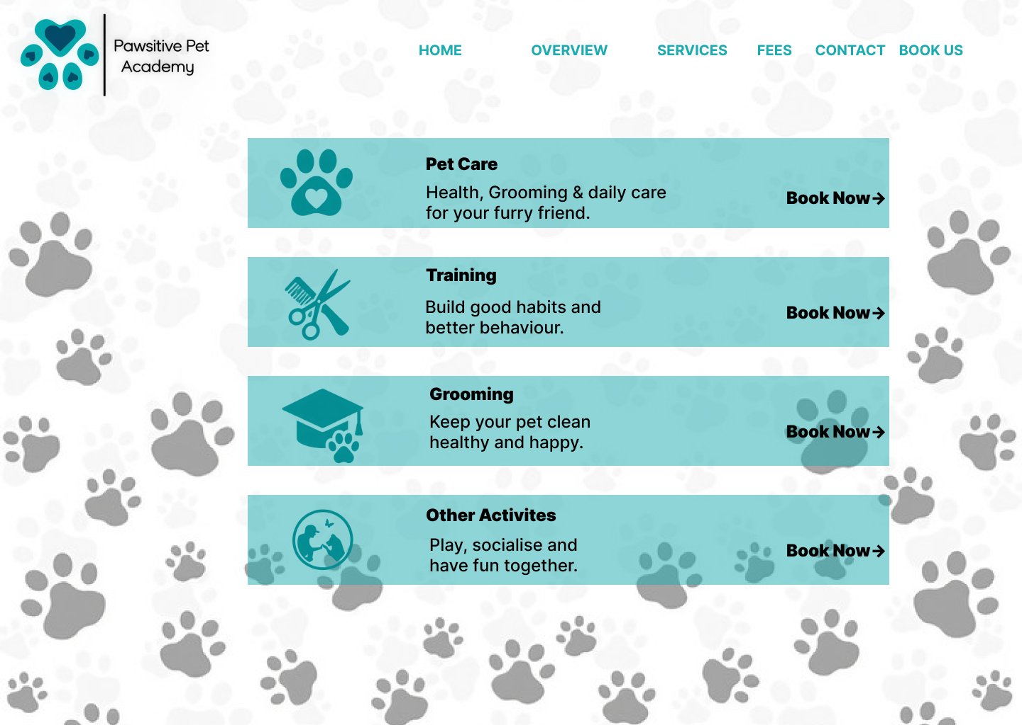

Slide 34
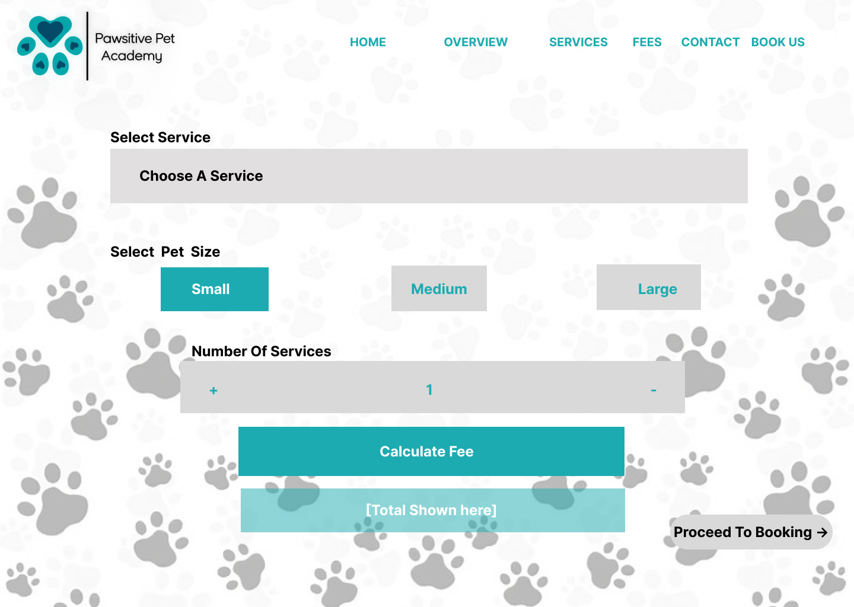

Slide 35
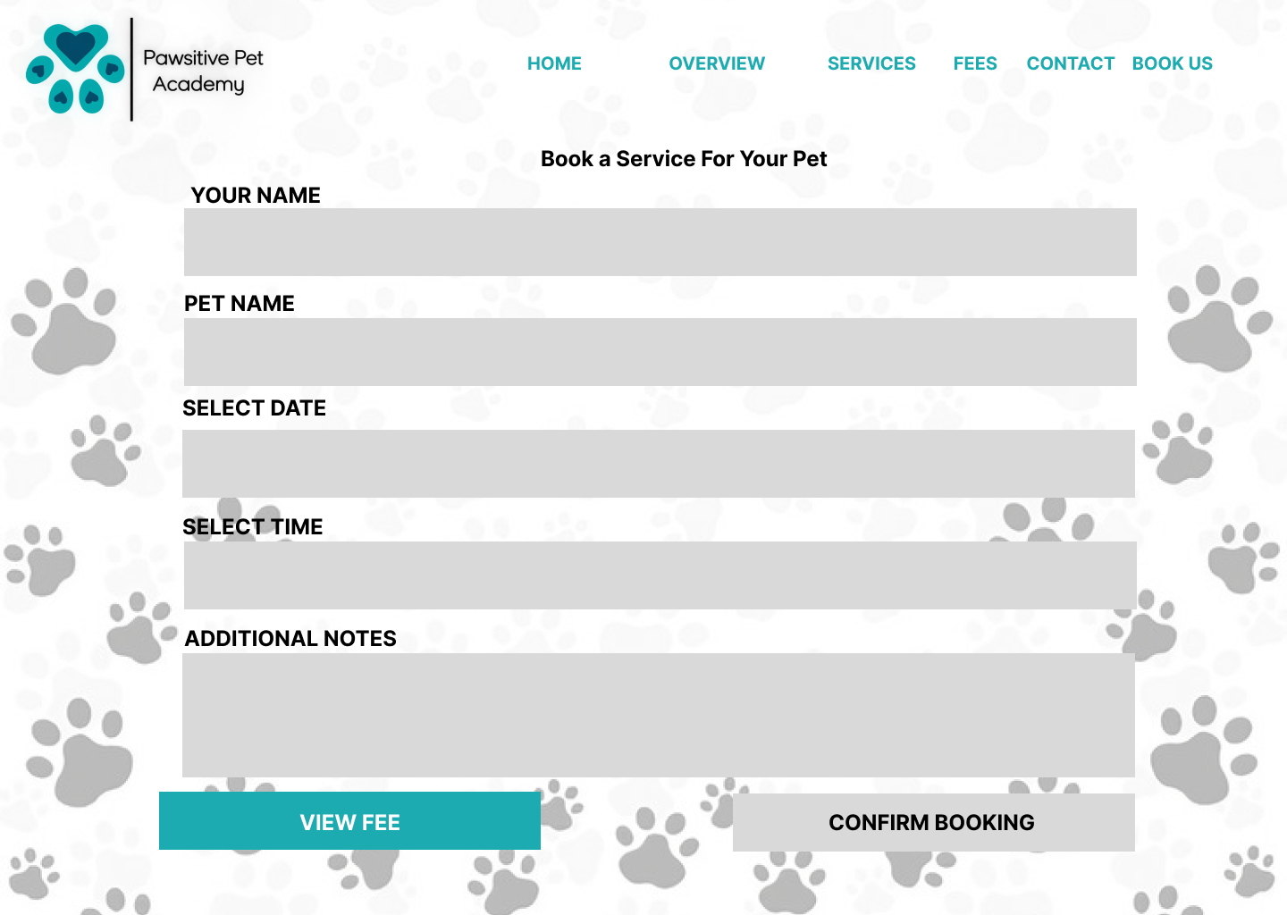

Slide 36
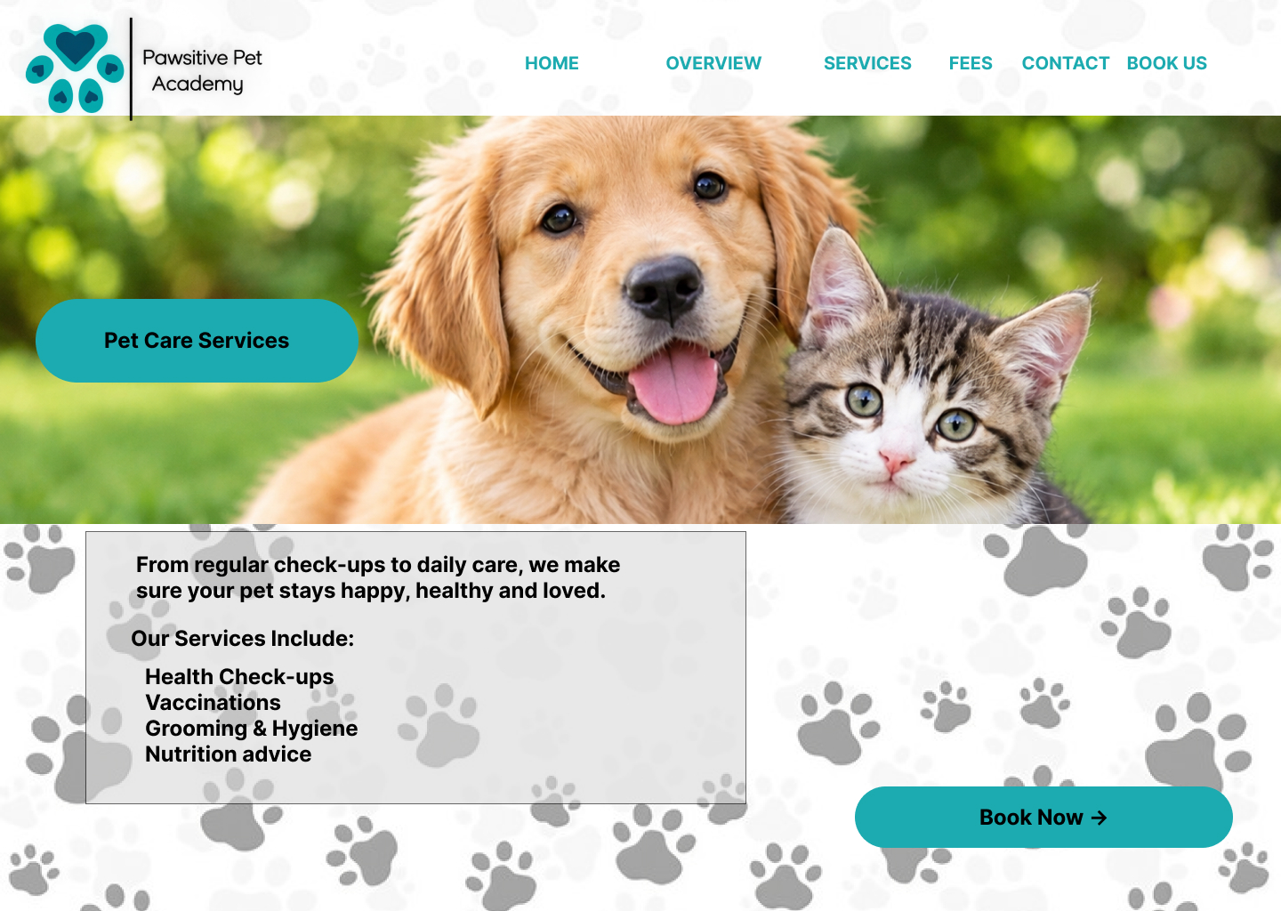

Slide 37
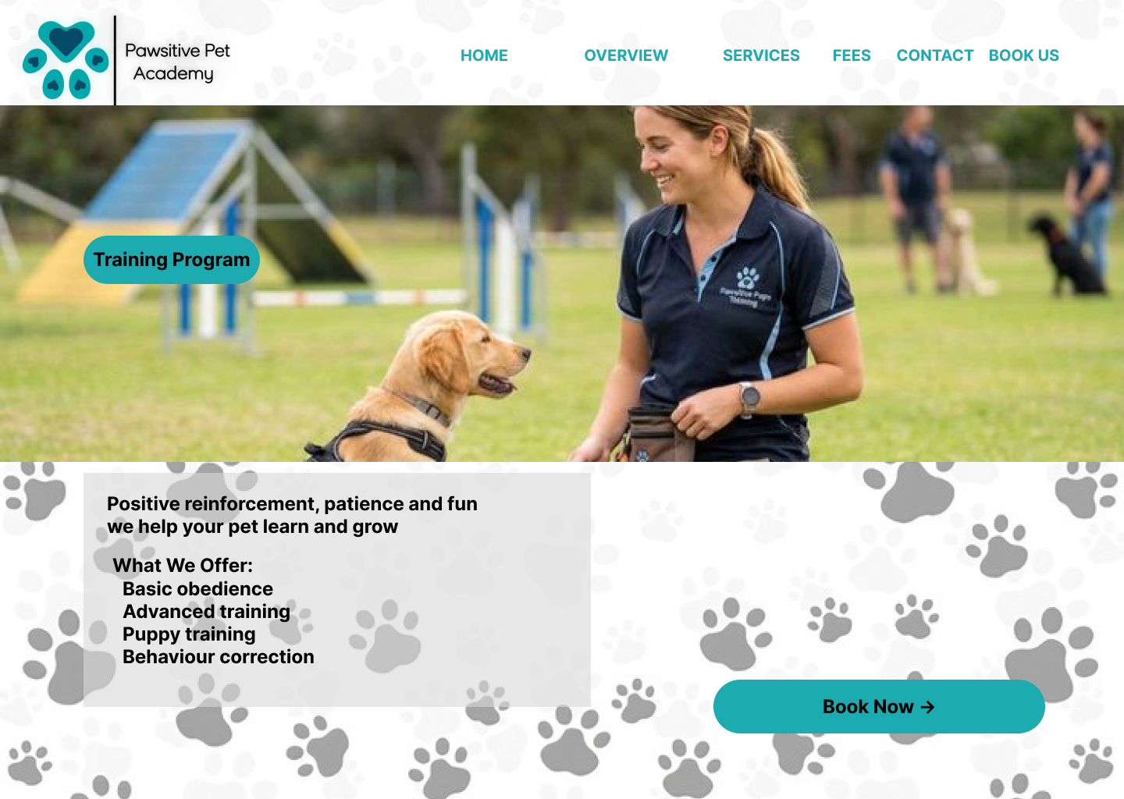

Slide 38
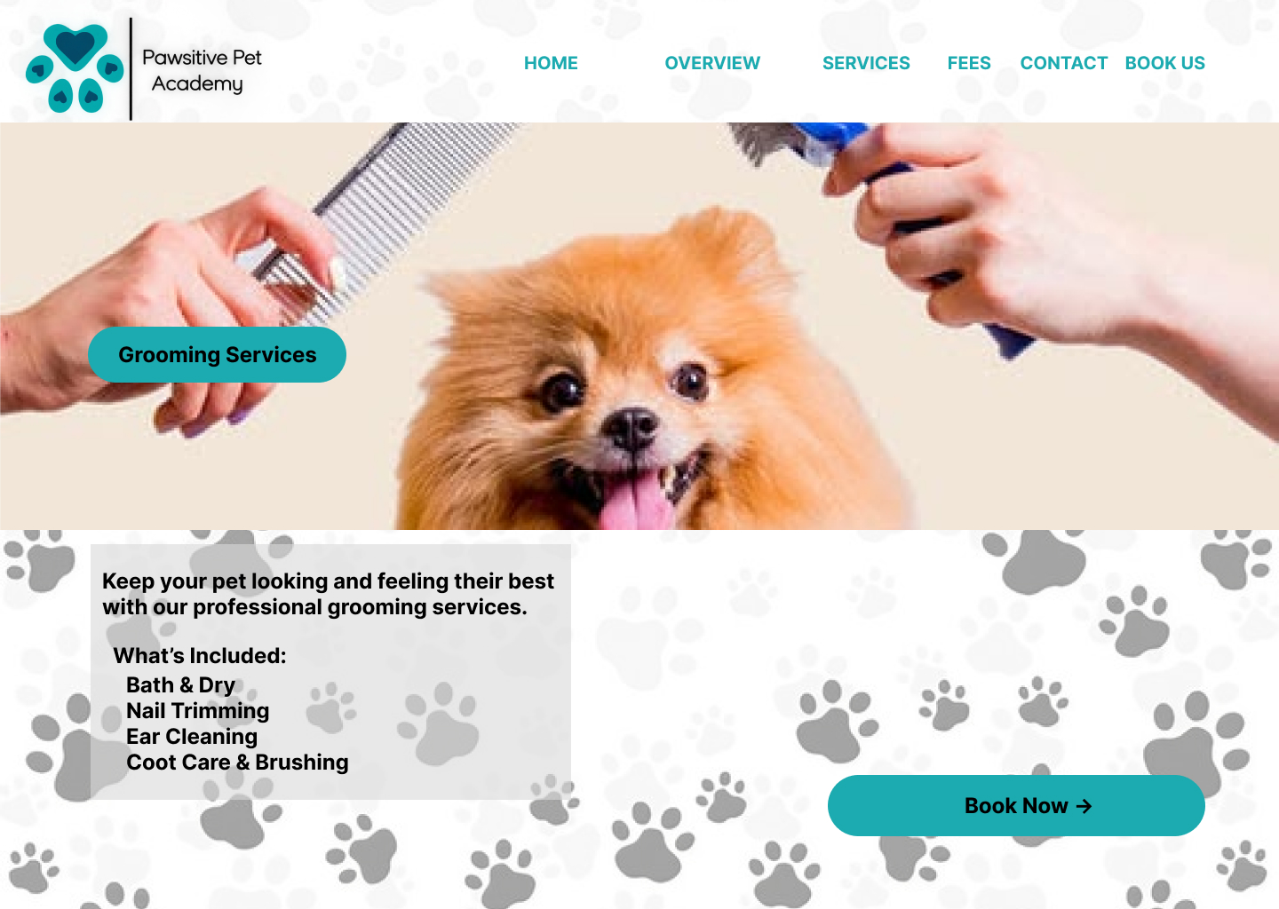

Slide 39
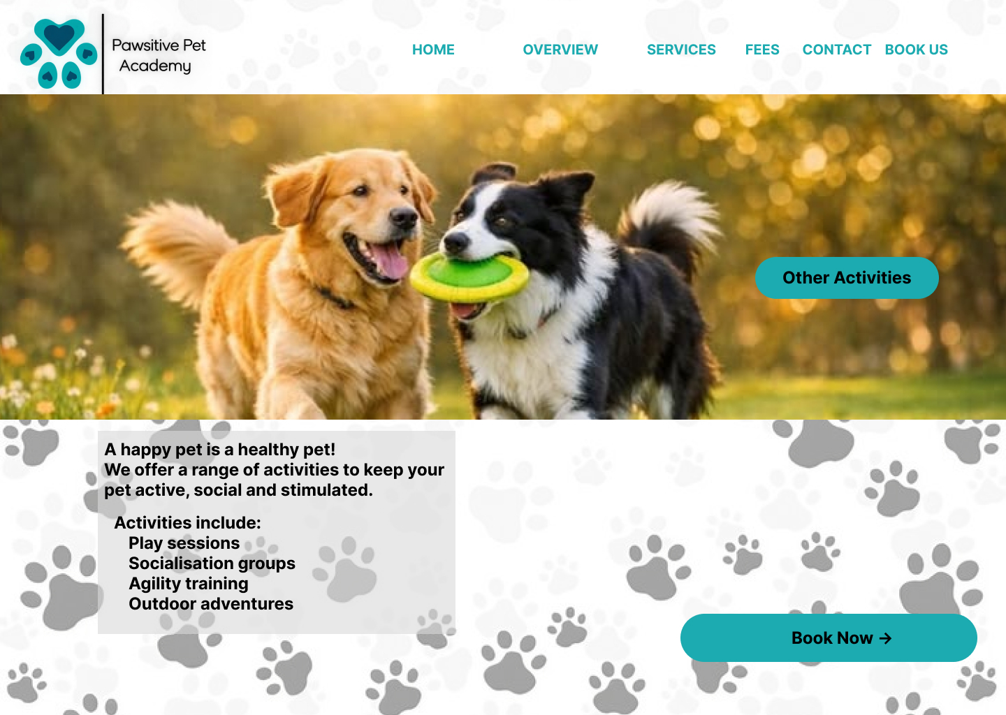

Slide 40
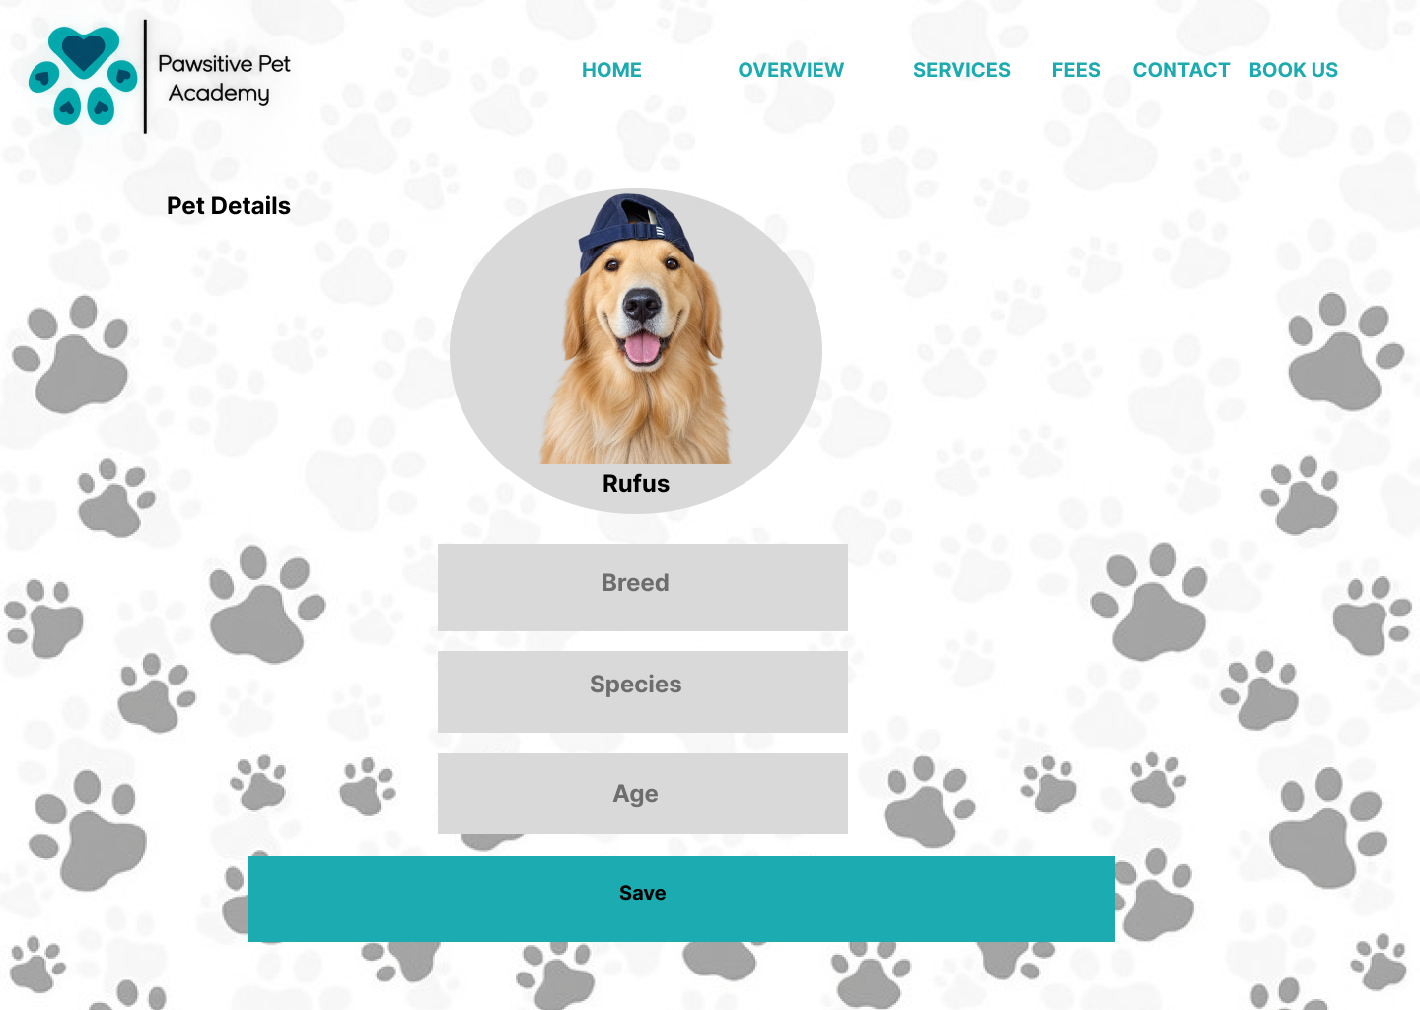

Slide 41
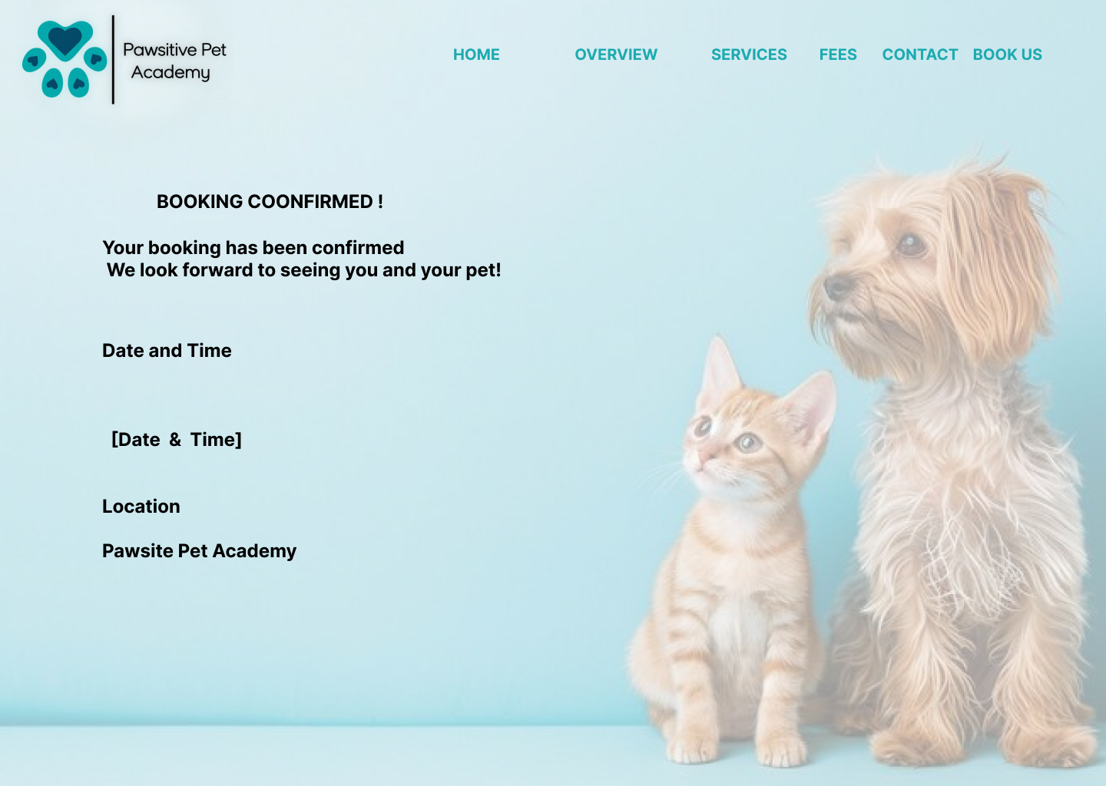

Slide 42


